Slide 1
SOLID Design Principles & Creational Design Pattern
Pramod Kumar
Notes:
SHORT TITLE

Slide 2
SOLID Principles
S : Single Responsibility Principle(SRP)
O : Open Closed Principle(OCP)
L : Liskov Substitution Principle(LSP)
I : Interface Segregation Principle(ISP)
D: Dependency Inversion(DI)
Introduced by Robert C Martin
Frequently referred in Design Pattern

Slide 3
Single Responsibility Principle(SRP)
A class should have single reason to change
Meaning it should have only one responsibility

Slide 4





Slide 5


Income getIncome(Employee e){
Income income = employeeRepository.getIncome(e.id); Payslip payslip = PayslipGenerator.get(income);
JsonObject payslipJson = convertToJson(payslip); EmailService.send(e.email, payslipJson);
…
return income;
}

Slide 6

class Utils{
void saveToDb(Object o){…} void convertToJson(Object o){…} byte[] serialize(Object o){…} void log(String msg){…}
String toFriendlyDate(LocalDateTime date){…}
int roundDoubleToInt(double val){…}
}

Slide 7

Income getIncome(Employee e){
RepositoryImpl repo = new RepositoryImpl(srv,port,db);
Income income = repo.getIncome(e.id); return income;
}

Slide 8
Open Closed Principle(OCP)
Open for extension but closed for modification
Lets see in the code

Slide 9









Liskov Substitution Principle(LSP)
This principle is discovered by Liskov
Substitute a sub class form a base class
Where ever base class is used, should be replaceable by sub class without modifying the functionality of the program.

Slide 10
Interface Segregation Principle(ISP)
Client should not be forced to depend the method that they don’t use
YAGNI : You Are Not Going to Need It
Lets see in the code

Slide 11








Slide 12
Dependency Inversion(DI)
Dependency Inversion is different from dependency injection
A. High level module should not depend on low level modules. Both should depend on abstraction.
B. Abstraction should not depend on details. Details should depend on abstraction.
Meaning if you can use interface instead of abstract classes so that you can substitute one implementation by another implementation without breaking anything.

Slide 13





Slide 14



Slide 15








Slide 16
High level module working together with low level modules
Geo Coding
Logging
MapQuest
Store in database
Email Notification

Slide 17





Slide 18

class SqlProductRepo{
public Product getById(String productId){
// Grab product from SQL database
}
}

Slide 19

class PaymentProcessor{
public void pay(String productId){ SqlProductRepo repo = new SqlProductRepo(); Product product = repo.getById(productId); this.processPayment(product);
}
}

Slide 20
interface ProductRepo {
Product getById(String productId);
}

Slide 21





class SqlProductRepo implements ProductRepo{
@Override
public Product getById(String productId){
// Concrete details for fetching a product
}
}

Slide 22


class PaymentProcessor{
public void pay(String productId){
ProductRepo repo = ProductRepoFactory.create();
Product product = repo.getById(productId); this.processPayment(product);
}
}

Slide 23
class ProductRepoFactory{
public static ProductRepo create(){ return new SqlProductRepo();
}
}

Slide 24
class ProductRepoFactory{
public static ProductRepo create(String type){ if(type.equals(“mongo”)){
return new MongoProductRepo();
}
return new SqlProductRepo();
}
}

Slide 25





Slide 26
Design Patterns
Solution to a commonly occurring problem in software design.
It’s a description or template for how to solve a problem
Gang of Four (GOF)
Types of design pattern

Slide 27
Creational Design Patterns
Singleton
Builder
Prototype
Factory
Abstract Factory

Slide 28

Concepts
Singleton design Pattern
Only one instance created
Guarantees control of a resource
Lazily loaded
Examples:
Runtime
Logger
Spring Beans
Drag picture to placeholder or click icon to add a graphic

Slide 29
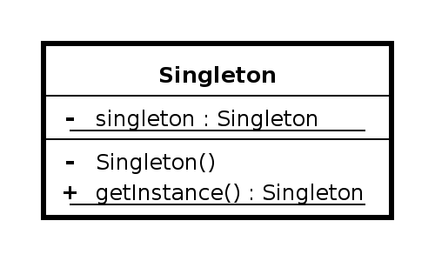
Design
Class is responsible for lifecycle Static in nature
Needs to be thread safe Private instance
Private constructor
No parameters required for construction

Slide 30

Exercise Singleton
Create Singleton
Demonstrate only one instance created
Lazy Loaded
Thread safe operation

Slide 31

Pitfalls
▪
▪
▪
▪
▪
Often overused Difficult to unit test
If not careful, not thread-safe Sometimes confused for Factory java.util.Calendar is NOT a Singleton

Slide 32

Singleton Summary
Guarantee one instance
Easy to implement
Solves a well defined problem
Don’t abuse it

Slide 33

Concepts
Builder Design Pattern
Handles complex constructors
Large number of parameters
Immutability
Examples:
StringBuilder
DocumentBuilder
Locale.Builder

Slide 34
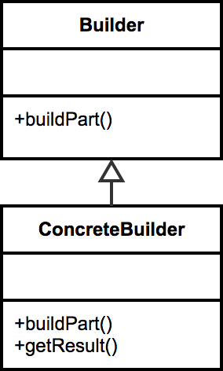
Design
Flexibility over telescoping constructors Static inner class
Calls appropriate constructor
Negates the need for exposed setters
Java 1.5+ can take advantage of Generics

Slide 35
Pitfalls
▪
▪
▪
▪
▪
Immutable
Inner static class Designed first Complexity
Method returns object

Slide 36

Concepts
Prototype Design Pattern
Avoids costly creation
Avoids subclassing
Typically doesn’t use “new”
Often utilizes an Interface
Usually implemented with a Registry
Example:
java.lang.Object#clone()
Drag picture to placeholder or click icon to add a graphic

Slide 37
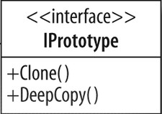
Design
Clone / Cloneable Avoids keyword “new”
Although a copy, each instance unique Costly construction not handled by client Can still utilize parameters for construction Shallow VS Deep Copy

Slide 38
Pitfalls
▪
▪
Sometimes not clear when to use Used with other patterns
Shallow VS Deep Copy
▪

Slide 39

Concepts
Factory Method DP
Doesn’t expose instantiation logic
Defer to subclasses
Common interface
Specified by architecture, implemented by user
Examples:
Calendar
ResourceBundle
NumberFormat

Slide 40
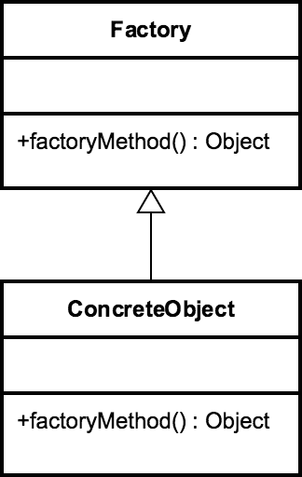
Design
Factory is responsible for lifecycle Common Interface
Concrete Classes Parameterized create method

Slide 41
Pitfalls
▪
▪
Complexity Refactoring

Slide 42
Concepts
Abstract Factories DP
Factory of Factories
Factory of related objects
Common Interface
Defer to Subclasses
Examples:
DocumentBuilder
Frameworks

Slide 43
Pitfalls
▪
▪
▪
▪
▪
Complexity Runtime switch
Pattern within a pattern Problem specific
Starts as a Factory

